Slide 1
Honda Car Specification Scraping – Team D
Mini Project – Evoastra Internship
Website: AckoDrive.com
Team Lead: Rakshada Renapurkar
Co-Lead: Subham Maharana
Date: 28 November 2025
Team Members:
Anurag Ojha
K Sai Kiran
Kota Aravind Kumar Reddy
Rakesh Dabbikar
Nazim Nazir

Slide 2
Problem Statement
Objective: Extract comprehensive variant-level specifications for Honda cars from AckoDrive.com
Key Challenges:
Dynamic JavaScript-rendered content
Multi-page navigation required
Variant-level detail extraction
100% data completeness target
Target: All Honda models with "Express Delivery" availability in Mumbai

Slide 3
Project Overview
Scraped: 27 Honda car variants across 3 models
Extracted: 8 key specification fields per variant
Achieved: 100% data completeness (0 missing values)
Cleaned: Professional data pipeline with type conversion
Documented: Complete notebook, report, and presentation
Models Covered:
Honda City (9 variants)
Honda Elevate (12 variants)
Honda Amaze (6 variants)

Slide 4
Parameters Extracted
This project captures the following key specifications:
Model Name
Veriant
Price
Fuel
Engine
Seating Capacity
Mileage
Transmission

Slide 5
Technology Stack
Language: Python
Libraries: BeautifulSoup, Selenium, Requests, re, CSV, Pandas
Tools: Google Colab

Slide 6
Why Selenium? (Not Just BeautifulSoup)
Static HTML Parsing: BeautifulSoup selected for excellent static parsing capability
Button Clicks: Selenium chosen for full button interaction capability
JavaScript Execution: Selenium selected for complete JavaScript support
Page Navigation: Selenium preferred for robust multi-page navigation
Dynamic Content: Selenium chosen for full dynamic content capture

Slide 7
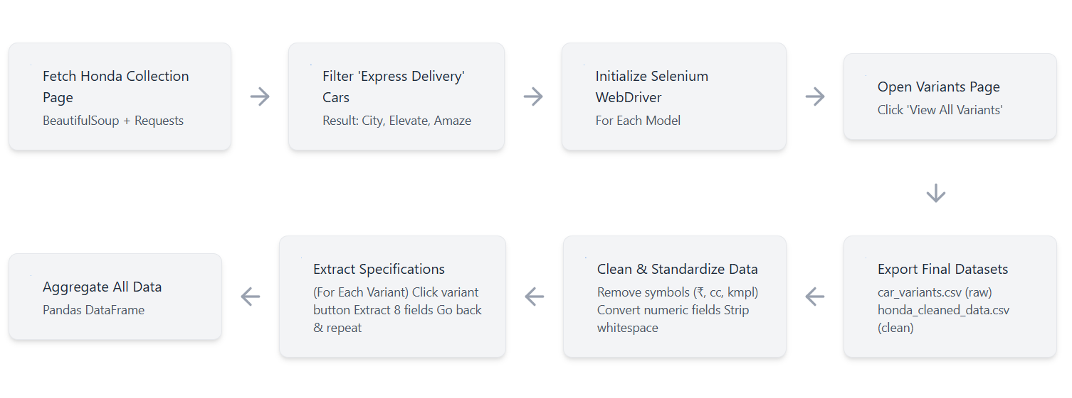
Workflow Diagram

Slide 8
Step-by-Step Scraping Approach
Access Honda collection page
Identify & collect all model URLs
Fetch each model’s specification page
Extract engine, mileage, seating, fuel, body type
Clean text & normalize outputs
Append to master dataset
Export final CSV

Slide 9
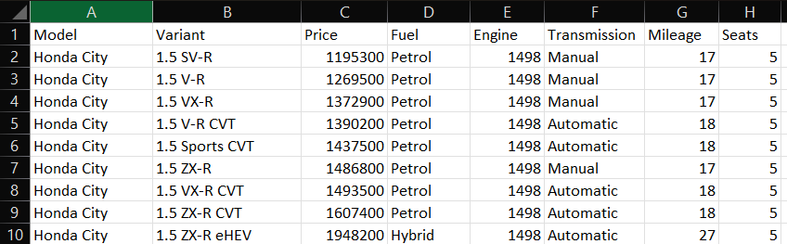
Dataset Snapshot

Slide 10
Data Cleaning
Price Cleaning: Removed ₹ symbol and commas, then converted to numeric float format
Engine Capacity: Eliminated "cc" suffix, stripped spaces, and converted to integer values
Mileage Data: Removed "kmpl" units and converted to floating-point numbers
Seating Capacity: Stripped "seater" text and converted to integer format
Text Fields: Applied whitespace stripping to all string columns for consistency
Result: Transformed raw scraped data into analysis-ready numeric formats while maintaining data integrity.

Slide 11
Key Insights
Mileage Leaders:
Overall: Honda City eHEV (27.0 kmpl)
Petrol Sedan: Honda City Manual (17.0 kmpl)
Petrol Automatic: Honda City CVT (18.0 kmpl)
Compact Sedan: Honda Amaze CVT (19.0 kmpl)
SUV: Honda Elevate Manual (15.0 kmpl)
Transmission Efficiency:
Manual Average: 16.5 kmpl
Automatic Average: 17.5 kmpl
Insight: CVT automatics deliver better fuel efficiency

Slide 12
Challenges Faced
Technical Challenges:
Stale element references (High frequency)
Dynamic content loading delays (Medium)
Discontinued variant filtering (Medium)
Variable page load times (Low)
Data Quality Challenges:
Inconsistent text formatting
Mixed data types (all strings)
Currency symbols in numeric fields
Unit suffixes requiring removal

Slide 13
Solutions Implemented
Technical Solutions:
Re-fetch elements after each navigation
Strategic 2-4 second waits after clicks
Detect .discontinued Badge class to skip cars
Try-except blocks for each specification
Code Quality Solutions:
Comprehensive exception management
Progress tracking and debugging logs
Set-based unique variant tracking
WebDriver cleanup in finally blocks
Data Quality Solutions:
Systematic symbol removal with regex
Explicit type conversion declarations
Null and duplicate validation checks

Slide 14
Final Deliverables
Code Artifacts
Honda_Car_Web_Scraping.ipynb - Fully documented notebook
Well-commented Python code with markdown explanations
Executable from top to bottom
Data Files
car_variants.csv - Raw scraped data (27 rows × 8 columns)
honda_cleaned_data.csv - Production-ready dataset
Documentation
Project Report - 36-page comprehensive technical document
Presentation - Professional slide deck (PDF)

Slide 15
Team Structure
Team Lead – Rakshada Renapurkar Planning, coordination, documentation | Web Scraping Team: Anurag Nazim Aravind | Report Team: Subham Rakshada
Co-Lead – Subham Maharana Monitoring, support, assistance | Data Cleaning Team: Rakesh Sai Kiran | Presentation Team: Rakshada

Slide 16
Conclusion
Project Success Metrics
100% Target Achievement - All 27 variants scraped
100% Data Completeness - Zero missing values
100% Team Participation - All members contributed
On-Time Delivery - Completed in 4 days
Quality Documentation - Professional deliverables
What We Demonstrated
Modern web scraping with browser automation
Handling dynamic JavaScript content
Professional data engineering practices
Ethical data collection
Team-based development workflow
Team D delivered production-quality code and analysis-ready data

Slide 17
Thank You
Team D – Honda Specification Scraping Project
Delivering clean data with clean code.

